Slide 1
Static Analysis – Establish Settings
AVCDL-Implementation-7.1.1
Charles Wilson
Staff Product Cybersecurity Architect
version 3
2026-01-27
Notes:
Script:
I'm Charles Wilson, staff product cybersecurity architect at Torc Robotics.
This presentation will cover the Static Analysis Settings Establishment activity.

Slide 2
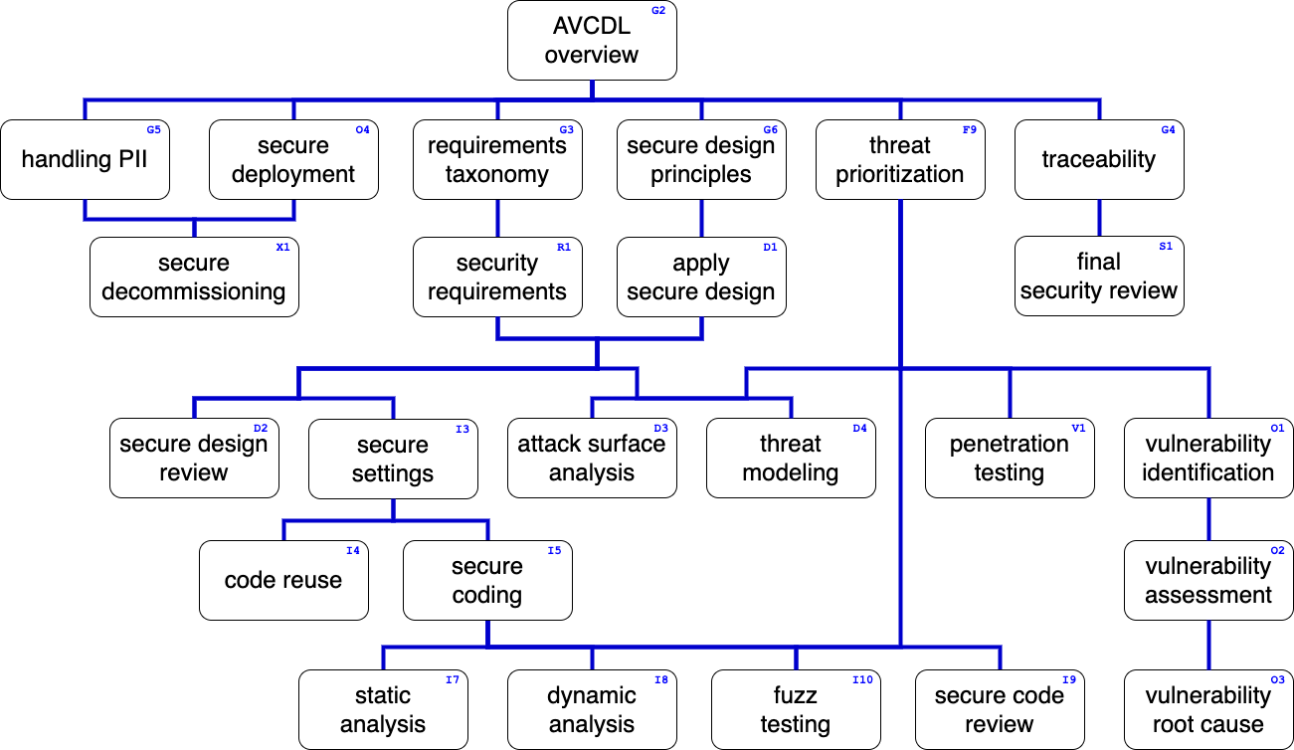
Training Path
Notes:
Script:
This diagram shows the overall AVCDL training path.
If you're taking this training, it's assumed that you've already completed the AVCDL Overview training,
and additionally, that you've completed the
Requirements Taxonomy
Security Requirements
Secure Design Principles
Apply Secure Design
Threat Prioritization
Secure Settings
Secure Coding
and
Static Analysis Overview
trainings.
This training will cover Static Analysis Settings Establishment.

Slide 3
Workflow
Notes:
Script:
Before getting into settings establishment, let's briefly review where it fits, in the overall static analysis process.

Slide 4
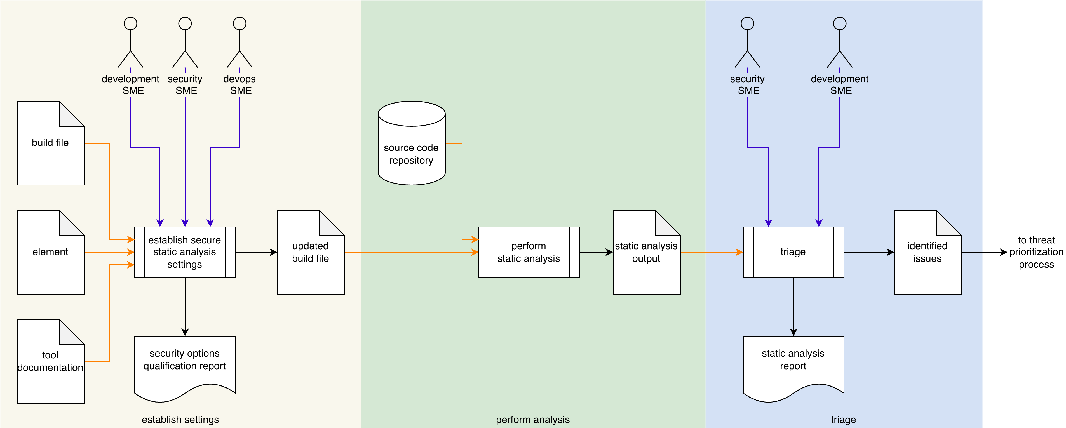
Process Workflow
Notes:
Script:
Here's the static analysis process which we previously covered in the Static Analysis Overview training.
[break]
Our focus for this training is going to be on the first activity, that of settings establishment.

Slide 5
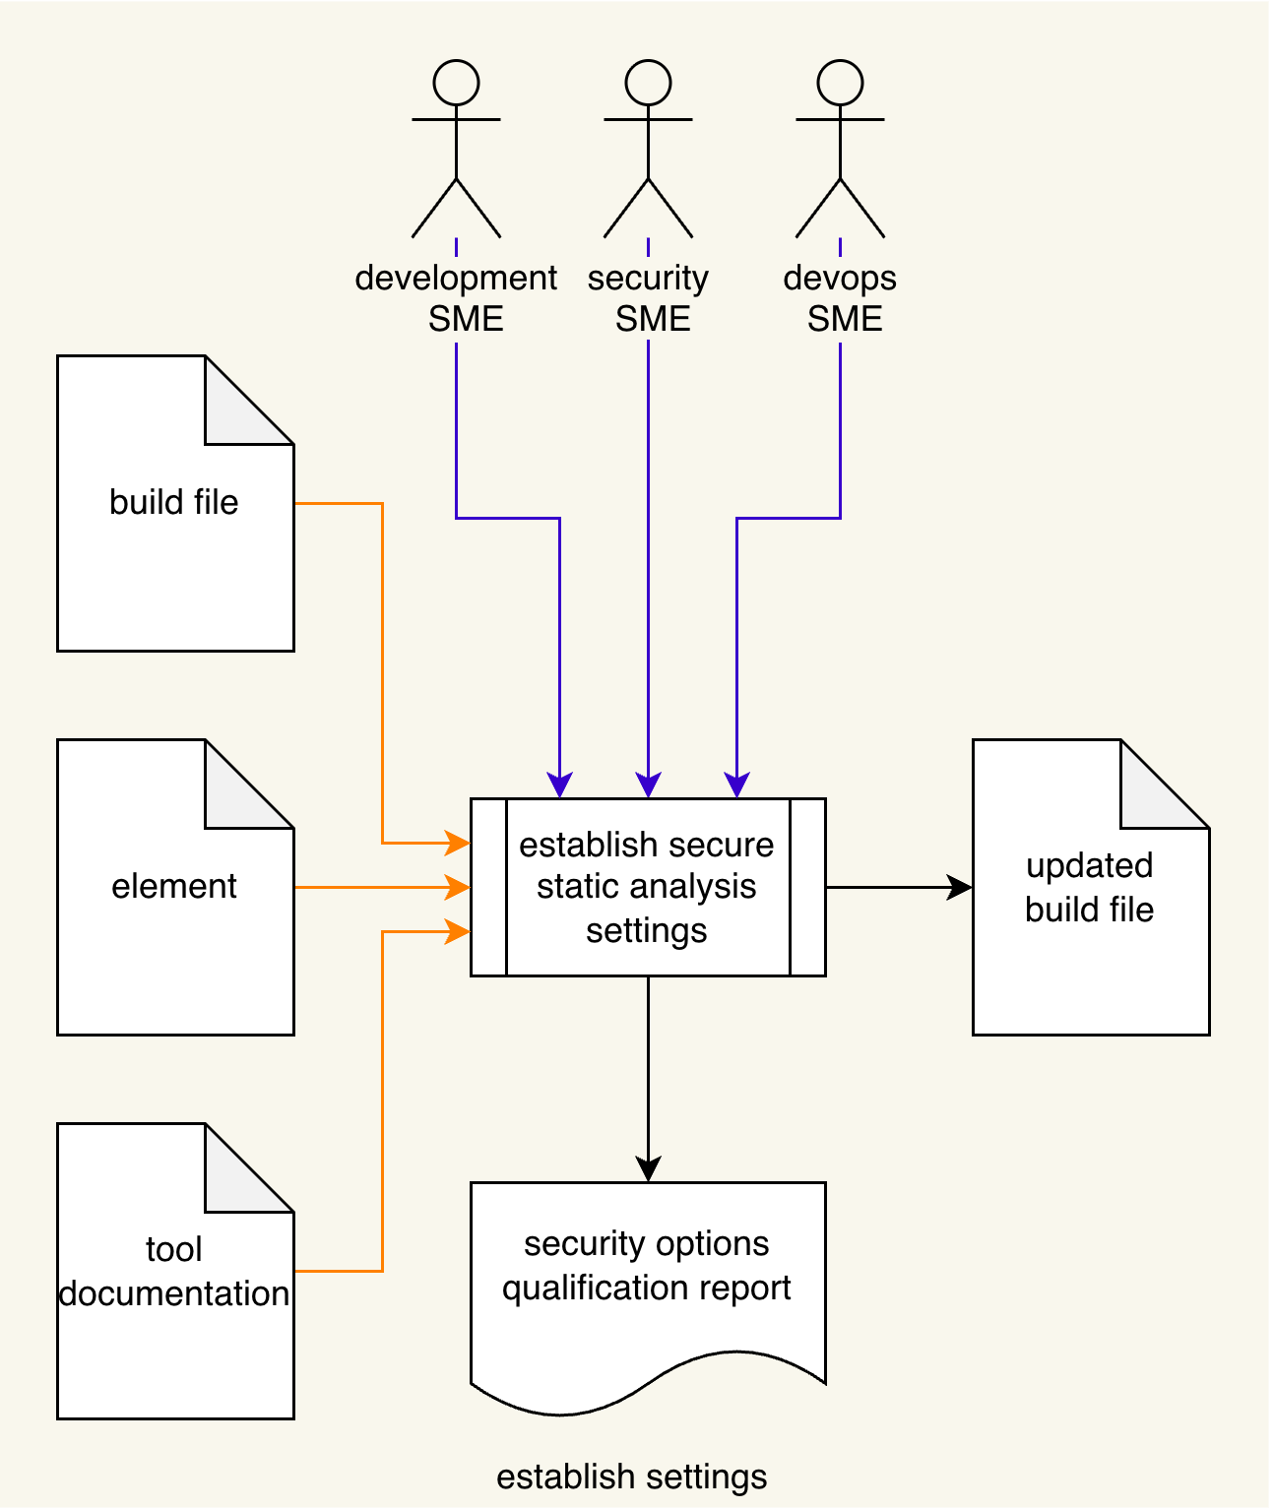
Process Workflow
Notes:
Script:
Here's the static analysis process which we previously covered in the Static Analysis Overview training.
[break]
Our focus for this training is going to be on the first activity, that of settings establishment.

Slide 6
Establish Settings Activity
Notes:
Script:
Within the settings establishment activity, the
• development
• security
and
• devops SMEs
take the
• tool documentation
• element documentation
and
• build file
and establish a set of element-specific settings
[pause]
creating an updated build file
[pause]
and generating a security options qualification report.
[pause]
Now, if this diagram seems really information dense, that's because this is an encapsulation of the secure settings process.
Let's revisit that process.

Slide 7
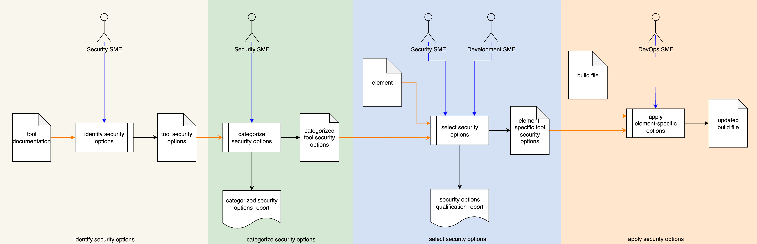
Secure Settings Process
Notes:
Script:
The secure settings process is comprised of four activities.
These are:
[break]
identifying the options relevant to cybersecurity
[break]
categorizing those options
[break]
selecting which ones we're going to use for each element
[break]
and finally, applying those options to the build system for that element.

Slide 8
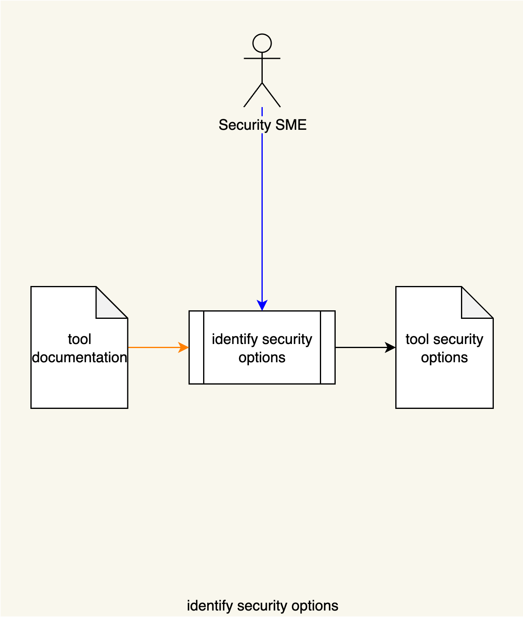
Secure Settings Process
Notes:
Script:
The secure settings process is comprised of four activities.
These are:
[break]
identifying the options relevant to cybersecurity
[break]
categorizing those options
[break]
selecting which ones we're going to use for each element
[break]
and finally, applying those options to the build system for that element.

Slide 9
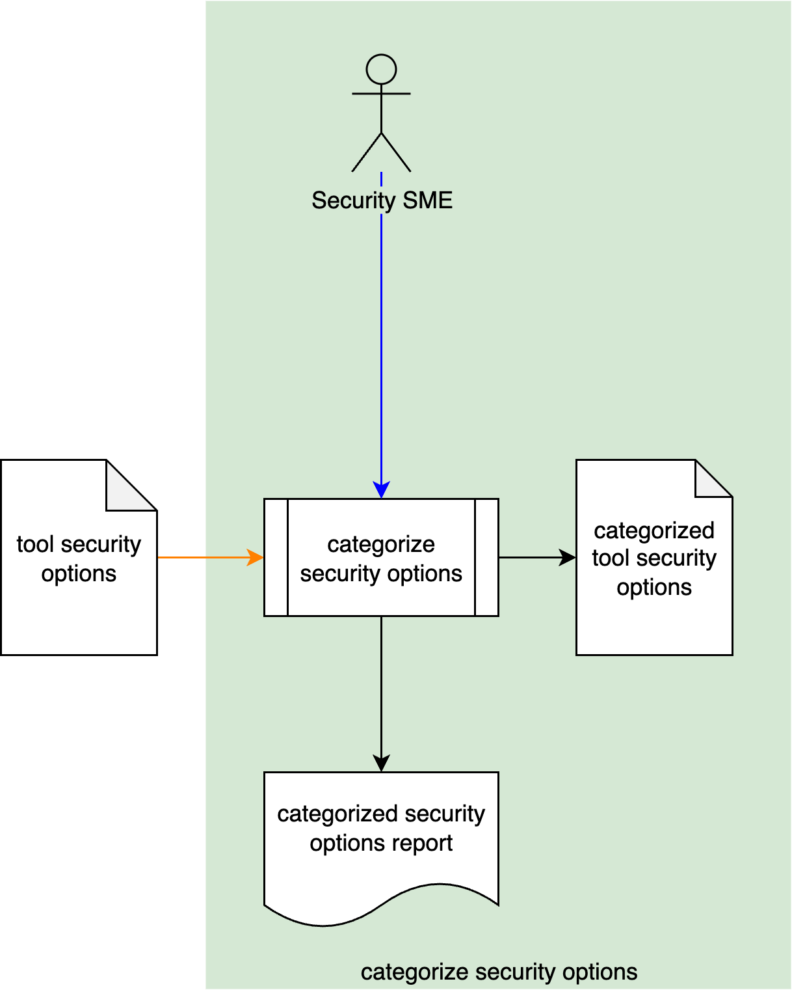
Secure Settings Process
Notes:
Script:
The secure settings process is comprised of four activities.
These are:
[break]
identifying the options relevant to cybersecurity
[break]
categorizing those options
[break]
selecting which ones we're going to use for each element
[break]
and finally, applying those options to the build system for that element.

Slide 10
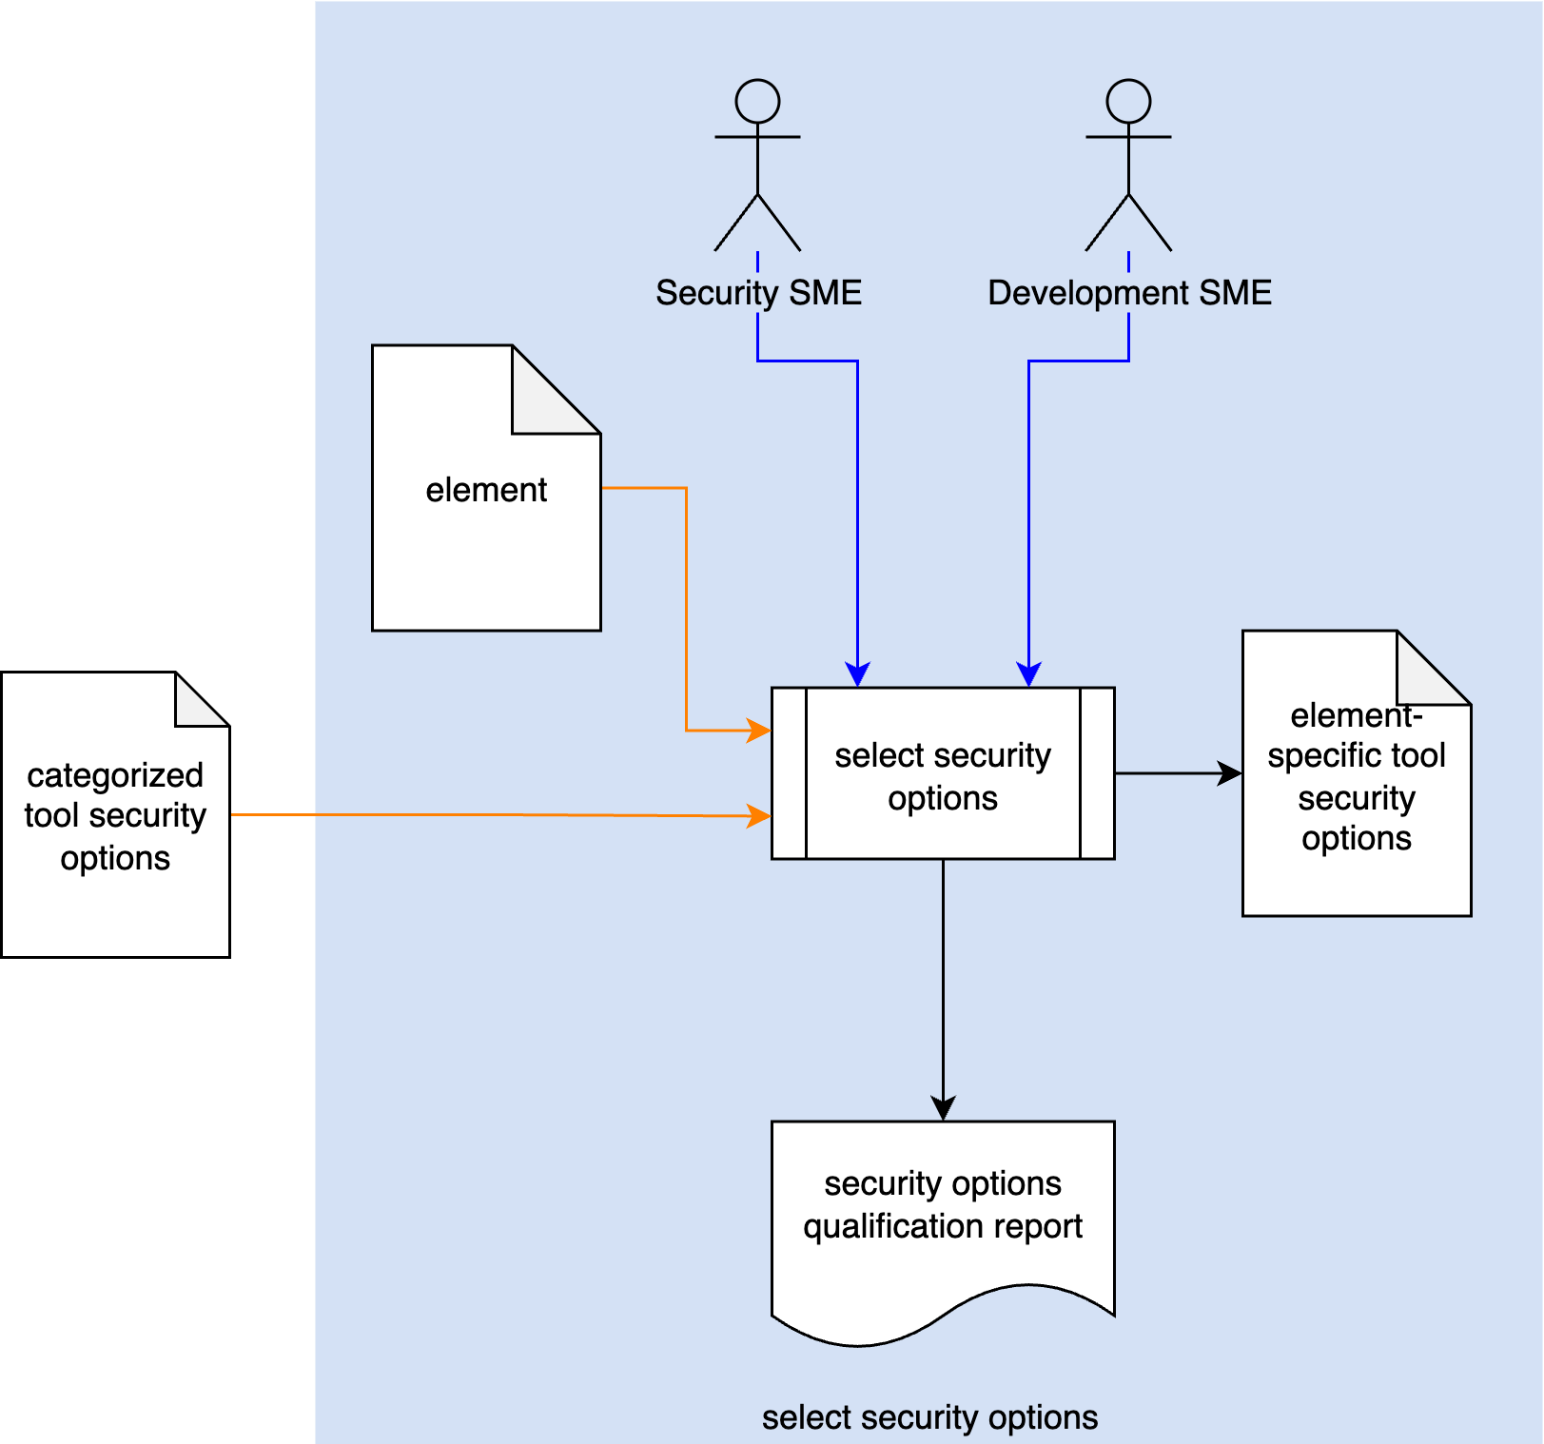
Secure Settings Process
Notes:
Script:
The secure settings process is comprised of four activities.
These are:
[break]
identifying the options relevant to cybersecurity
[break]
categorizing those options
[break]
selecting which ones we're going to use for each element
[break]
and finally, applying those options to the build system for that element.

Slide 11
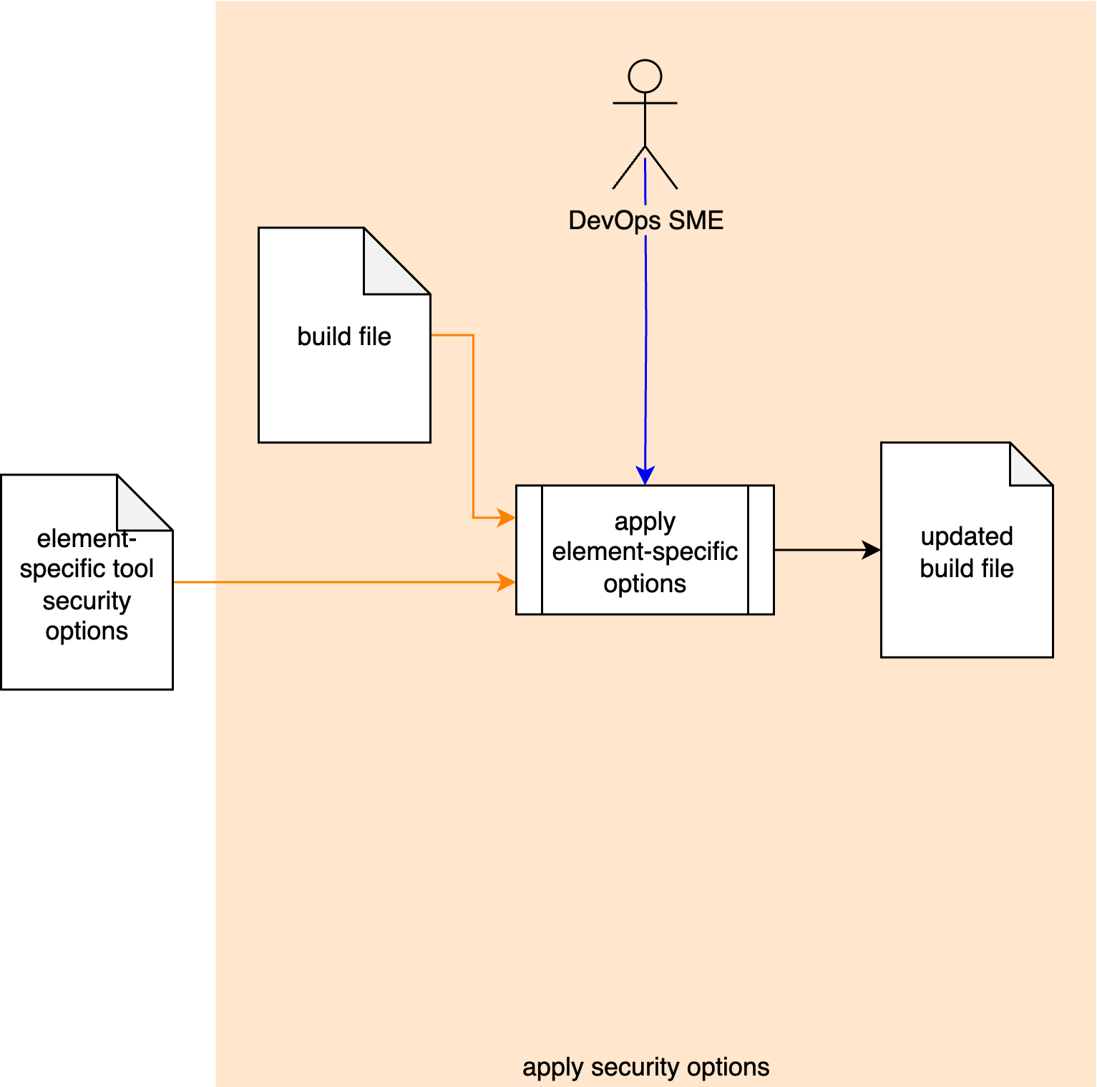
Secure Settings Process
Notes:
Script:
The secure settings process is comprised of four activities.
These are:
[break]
identifying the options relevant to cybersecurity
[break]
categorizing those options
[break]
selecting which ones we're going to use for each element
[break]
and finally, applying those options to the build system for that element.

Slide 12
Secure Settings Material
Notes:
Script:
Now, let's briefly review the materials that provide both documentation and training for how the secure settings activities should be undertaken.

Slide 13
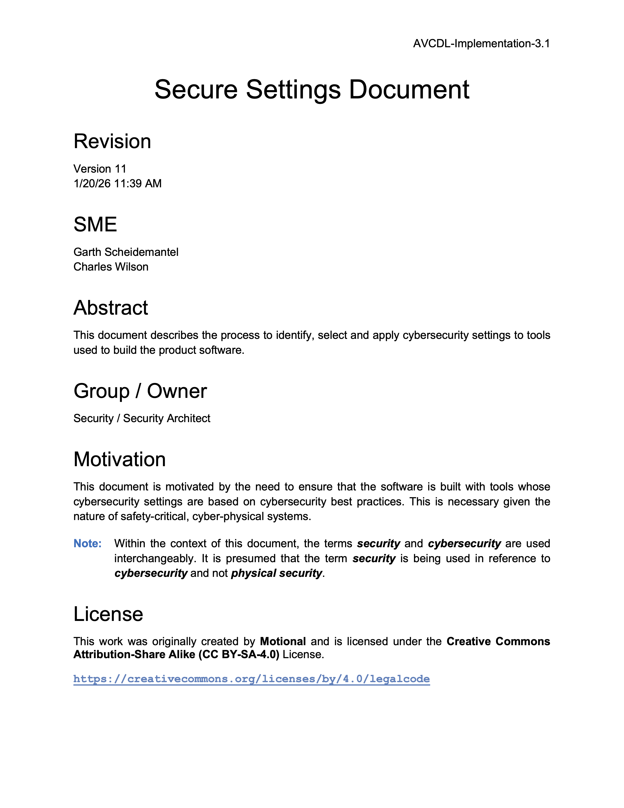
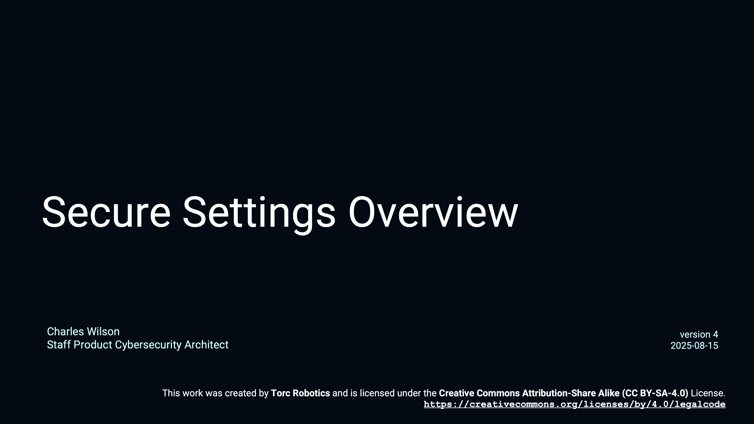
Secure Settings - Overview
Notes:
Script:
First, we have the Secure Settings Overview training video which compliments
the Secure Settings Document secondary document
and provides an overview of the secure settings process described in the AVCDL primary document.

Slide 14
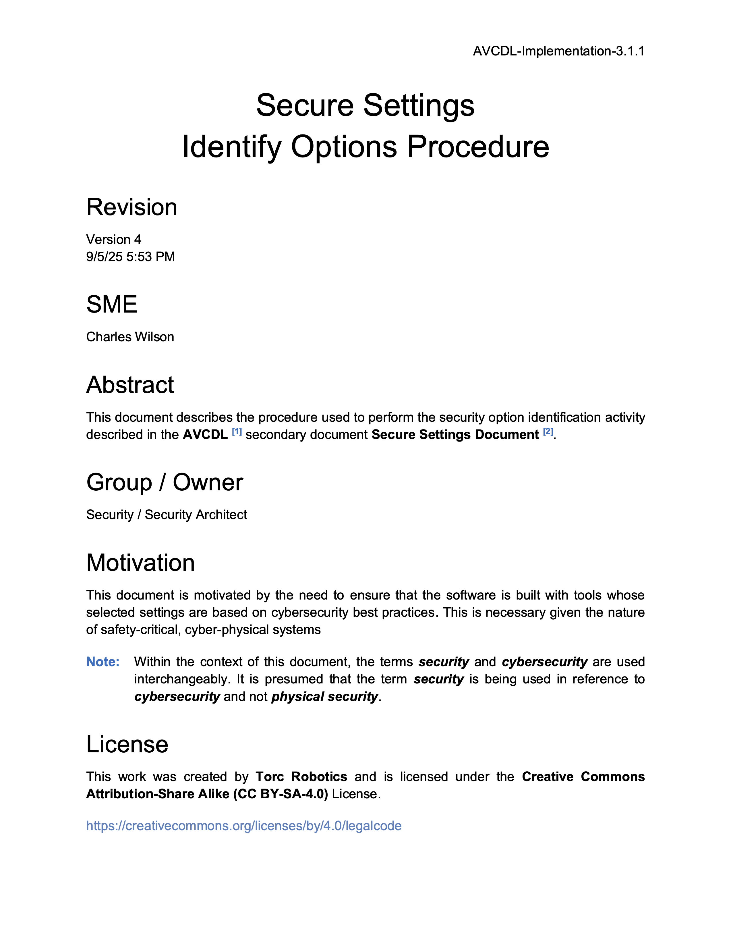
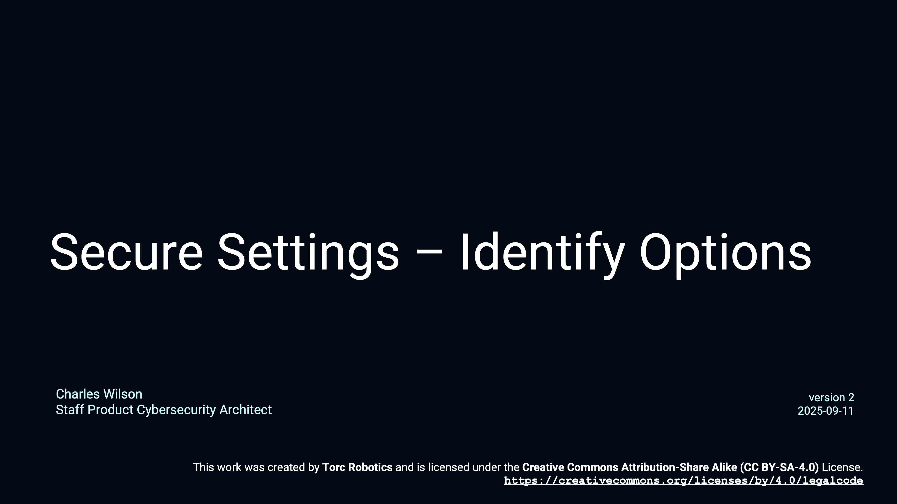
Secure Settings – Identify Options
Notes:
Script:
The Secure Settings - Identify Options training goes along with the Secure Settings Identify Options Procedure.
It works its way through an example using GCC as a basis covering how one would take a tool and extract the various cybersecurity-relevant options from it.

Slide 15
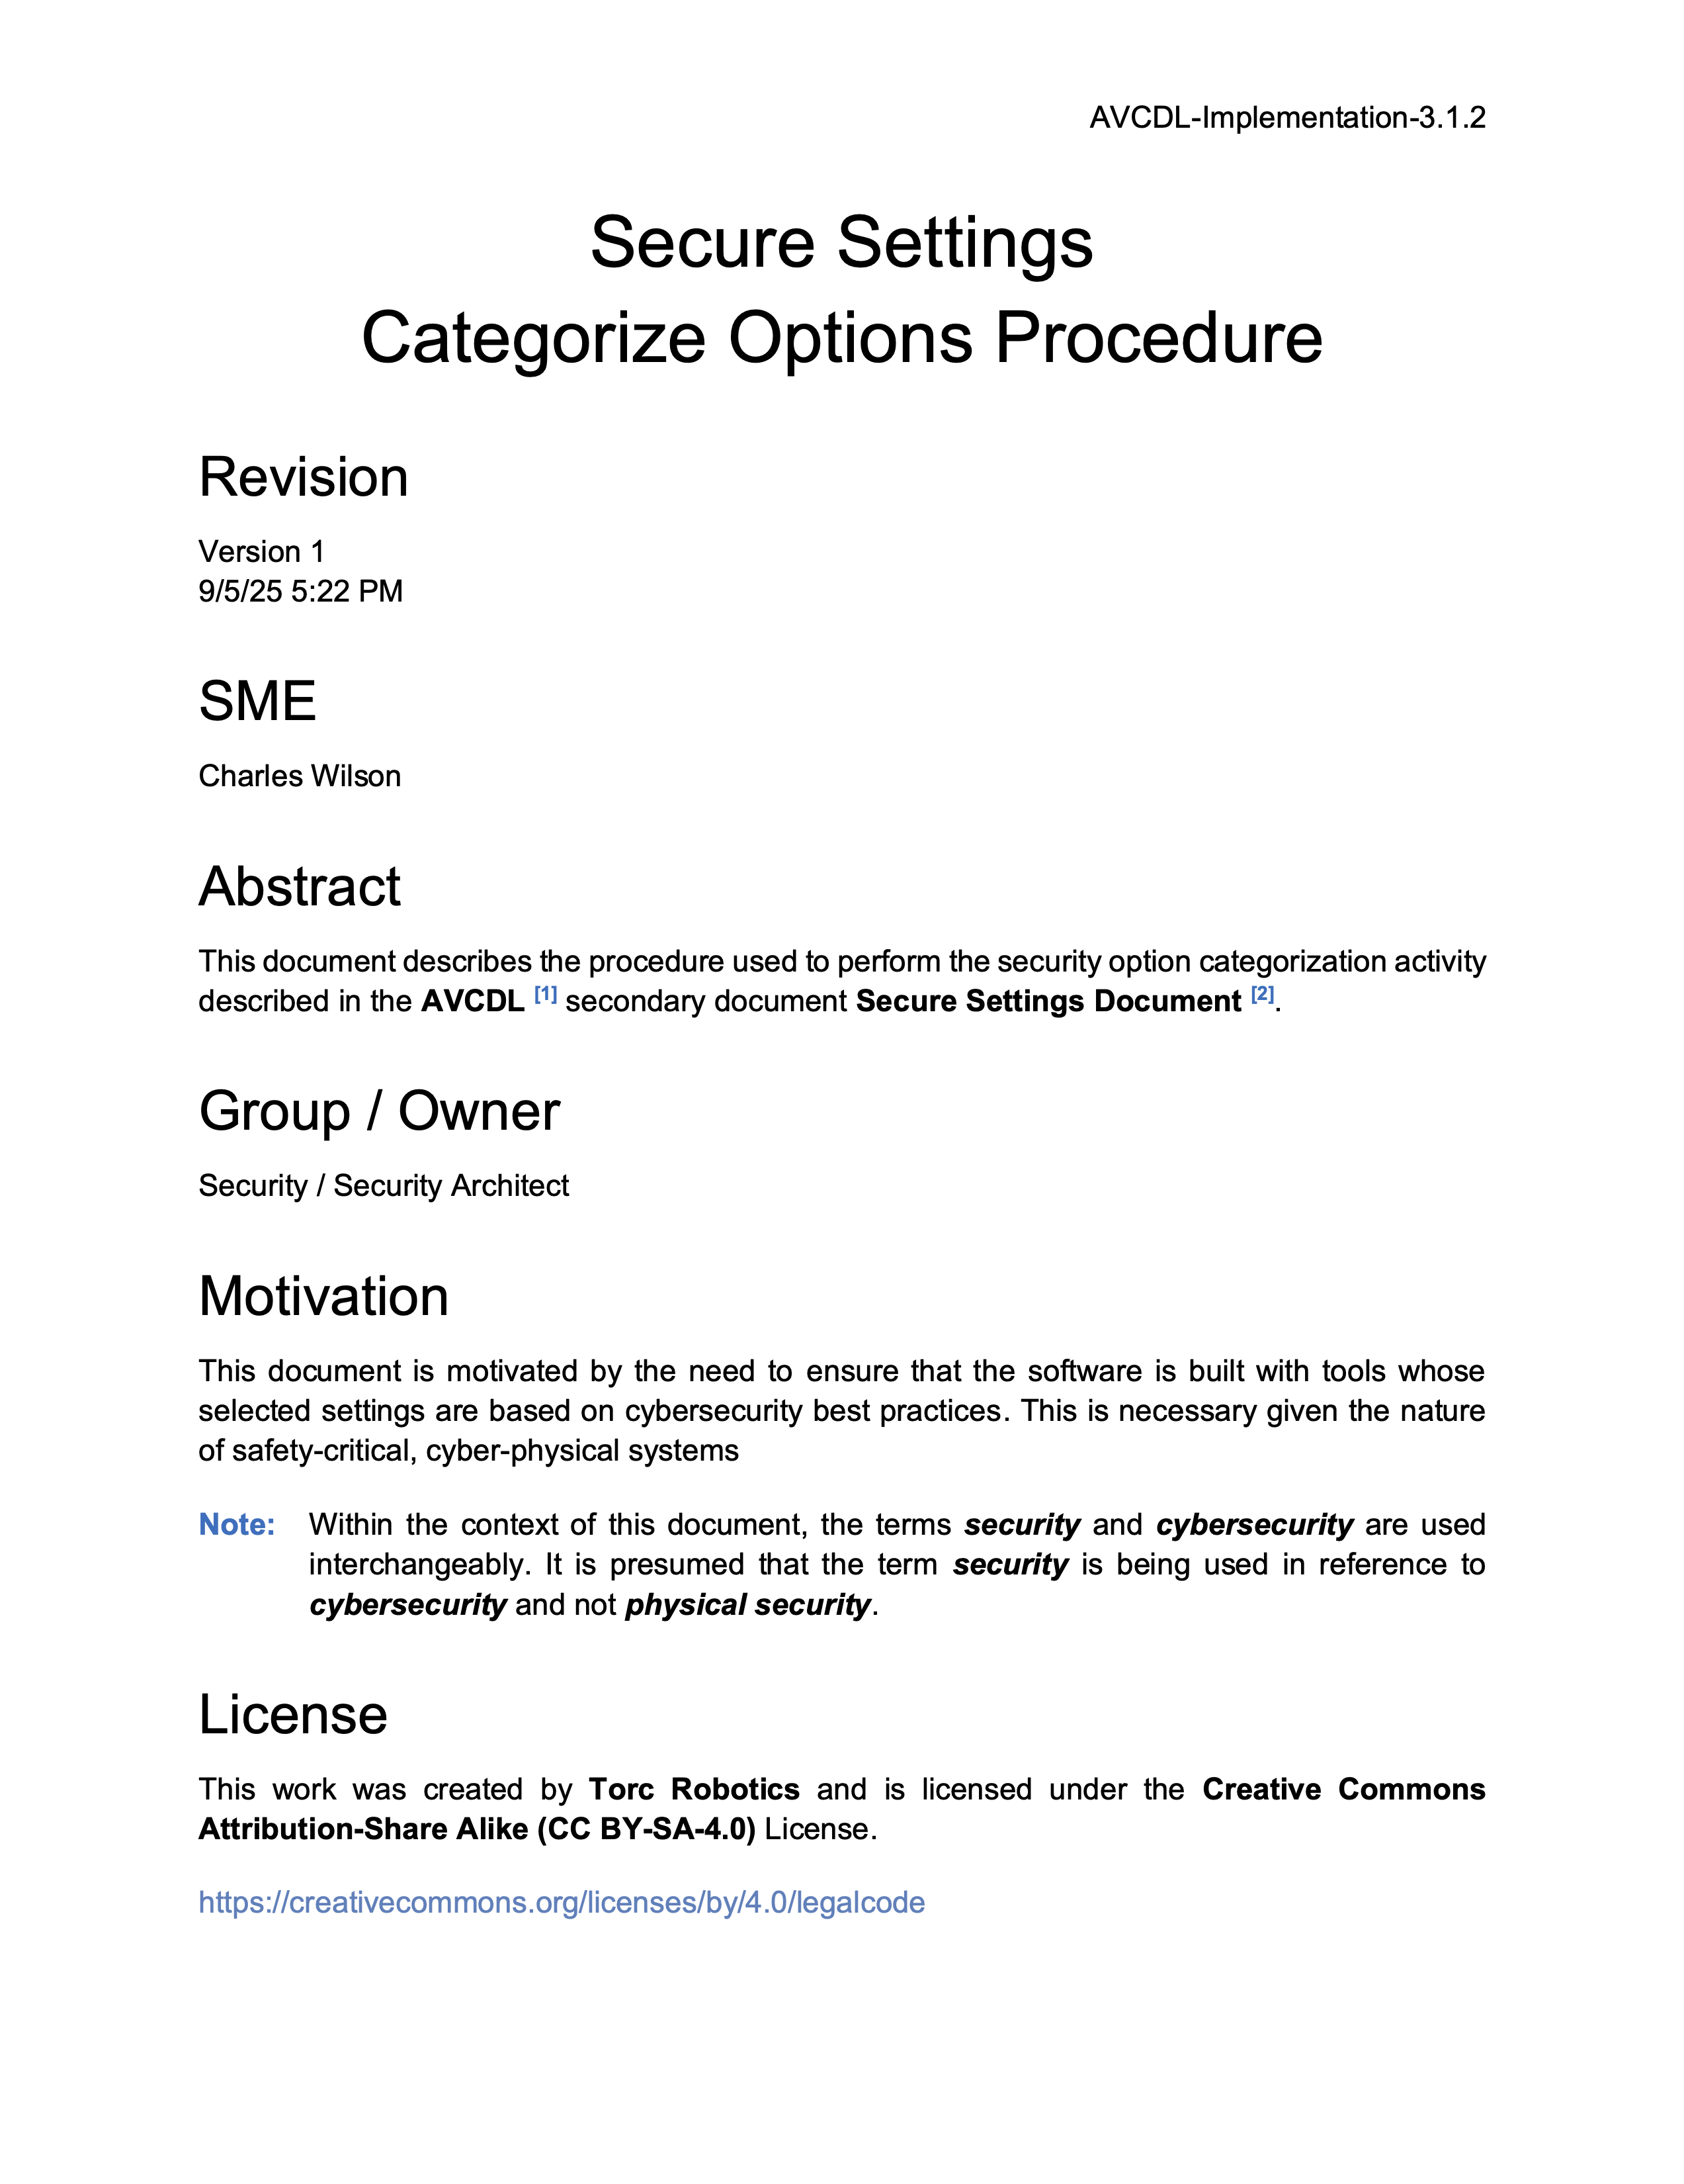
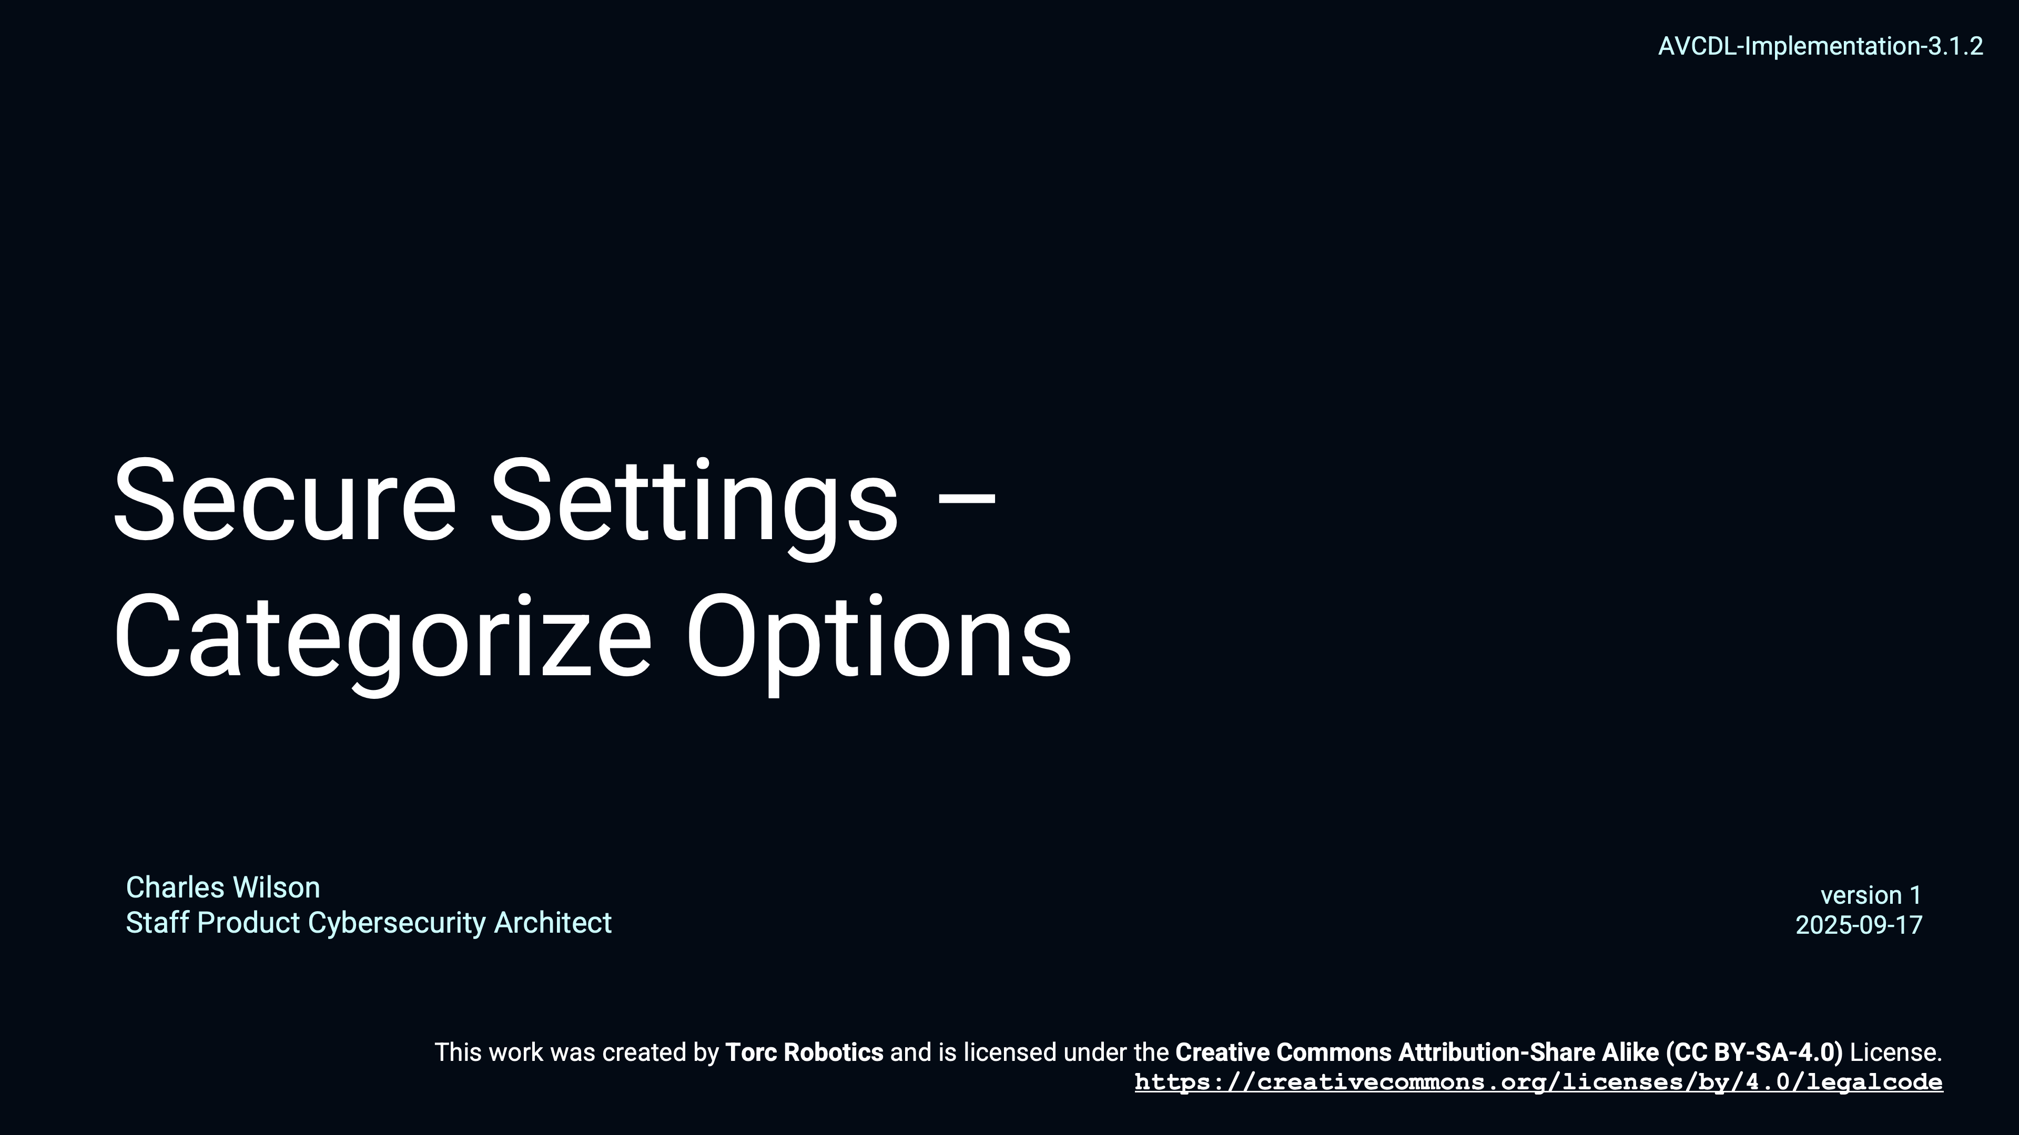
Secure Settings – Categorize Options
Notes:
Script:
The Secure Settings - Categorize Options training goes along with the Secure Settings Categorize Options Procedure.
It extends the example from the identify options training and covers how one might create severity categories and categorize the identified options so that they can be processed later.

Slide 16
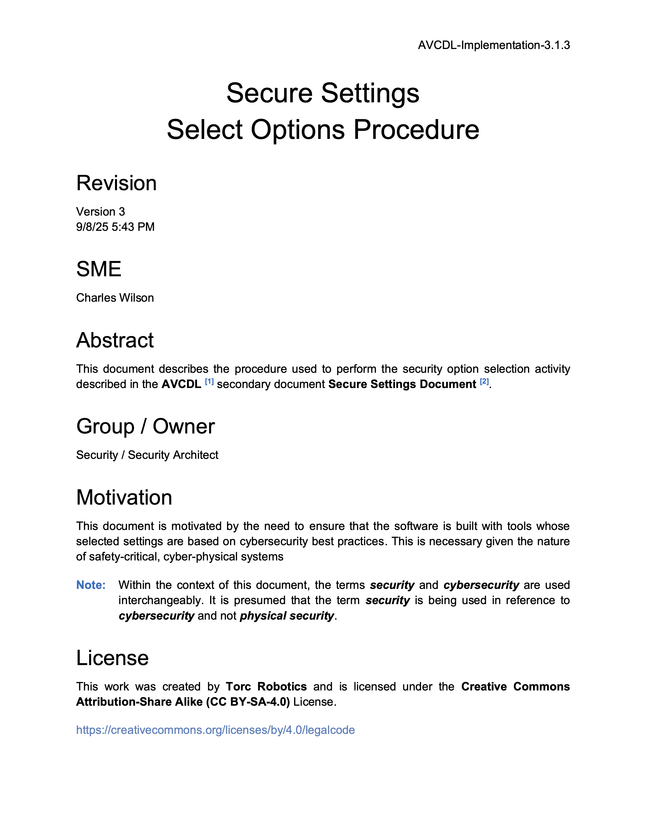
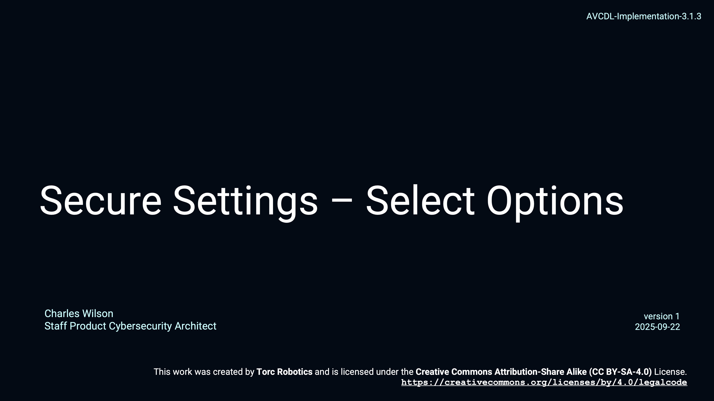
Secure Settings – Select Options
Notes:
Script:
The Secure Settings - Select Options training goes along with the Secure Settings Select Options Procedure.
It continues extending the example from the previous training and addresses how options are selected for application to a specific element of the system by the cybersecurity and development SMEs.

Slide 17

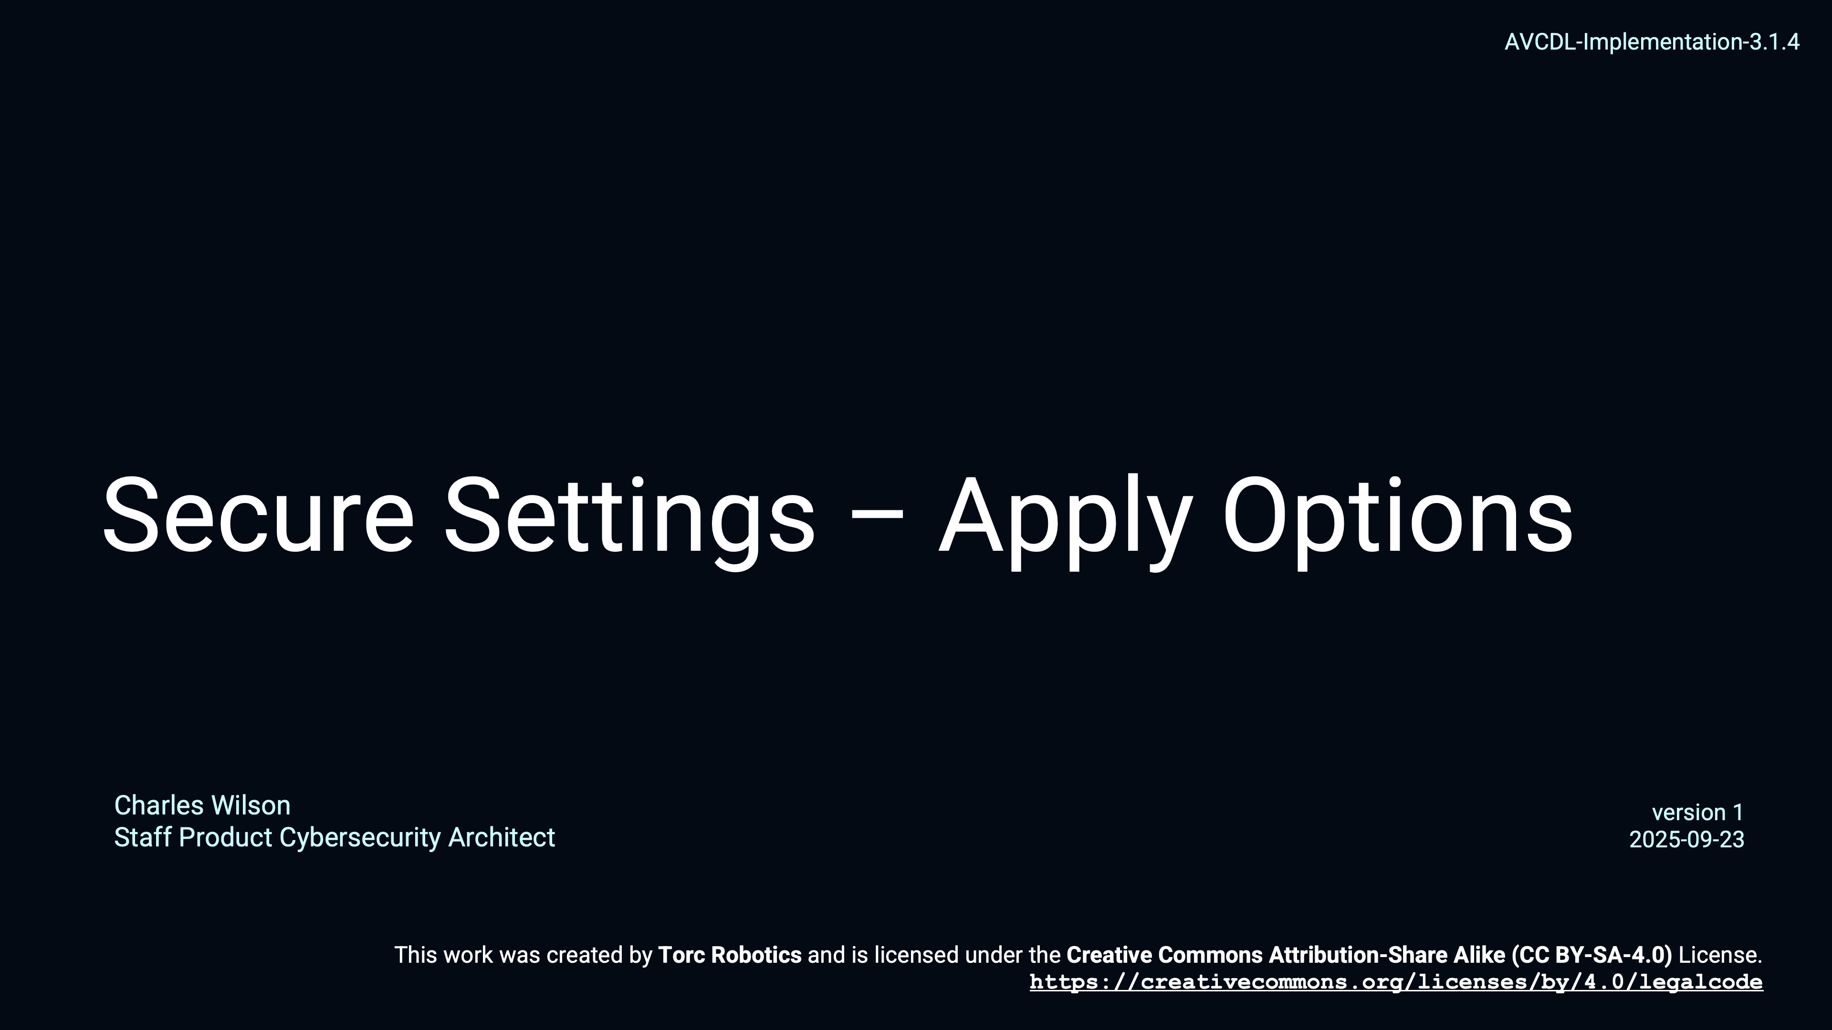
Secure Settings – Apply Options
Notes:
Script:
Finally, the Secure Settings - Apply Options training goes along with the Secure Settings Apply Options Procedure.
The focus here is on the devops SME, tasked with taking the options selected for application to a particular element, and making the adjustments to the build system to integrate those options.

Slide 18
Static Analysis Considerations
Notes:
Script:
Since the Secure Settings process activities speak in general, let's talk about the specific things we need to consider when establishing the static analysis settings.

Slide 19
Considerations
Relevant
Released
Practical
Consistent
Identify
Categorize
Maturity
Impact
Interaction
Execution
Select
Apply
Notes:
Script:
Let’s first consider the identify options activity.
Because static analysis tools are not primarily designed for cybersecurity-specific analysis, you have to put in a fair amount of work in order to identify which ones are truly cybersecurity relevant.
The focus should be on those options that are truly cybersecurity relevant and not simply adjacently interesting.
[pause]
A second point is that because of the nature of static analysis tools, false positive results are unavoidable.
As such, it's highly recommended that only released options be considered.
There is a tendency within software development to gravitate toward the new shiny, the new shiny compiler, the new shiny optimization.
If a non-release or experimental option is put in place and it generates output which is not useful or generates excessive false positives, this reduces the credibility of cybersecurity because the expectation is that cybersecurity will provide only high quality, valid, and actionable issues to development.
[pause]
Within the context of the categorize options activity, it's important that when we create categories that they be practical.
This point is covered in the Secure Settings - Categorize Options training, but it's worth emphasizing here.
It’s recommended to use a must-do / may-do approach.
Also, resist the urge to assign everything to must-do.
[pause]
Additionally, be consistent.
Don't arbitrarily assign options to a category because you think there should be a balance.
It's not about balance.
It's about appropriate categorization that leads to positive cybersecurity outcomes.
[pause]
Next in the select options activity, what we're considering here is the element, and this has two aspects.
[pause]
The first is the maturity of the static analysis process as applied to the element.
We don't want to overwhelm development with an avalanche of issues.
[pause]
Related to maturity is that when you're selecting from the identified options, do so based on impact.
Instead of selecting lots of inconsequential options, which might generate one or two issues per thousand files, select options which are going to have a large cybersecurity impact.
[pause]
Finally, when we are doing the apply options activity, it's important to recognize that unless you are using a stand-alone static analysis tool which applies all of its rules independent of each other that there may be interaction between the selected options.
This is especially true when dealing with compilers.
There are compiler settings which will either preclude the use other options or enable other options.
A good example of this can be found within the C and C++ compilers.
When you use a warning of all or pedantic, multiple options are enabled.
[pause]
The other thing to consider is that there will be an impact to the execution time on the build process.
It cannot be emphasized enough that static analysis is a time consuming activity, and it should be adopted judiciously.
Just dropping static analysis into the build process may blow through resource budgets; whether they be time or storage related.

Slide 20
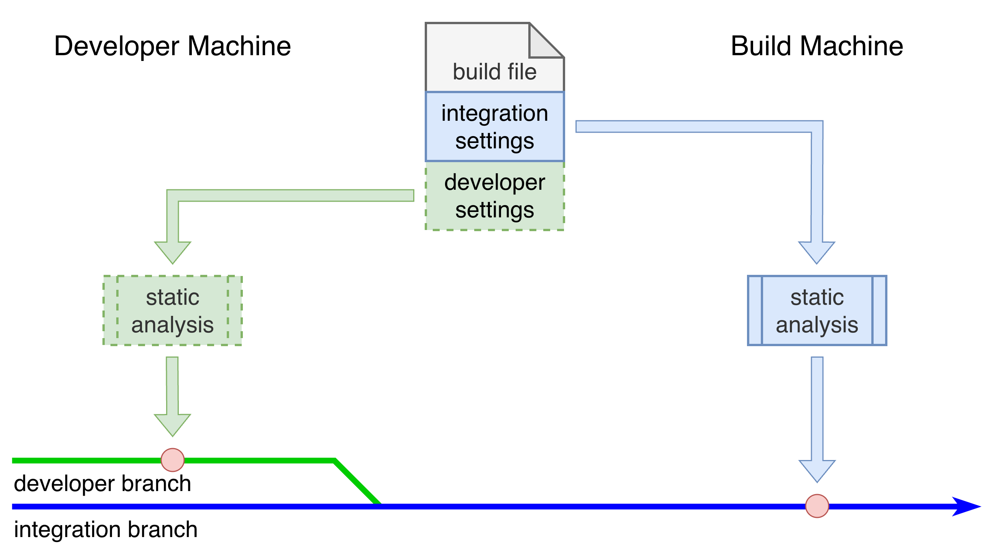
Considerations
✓
X
Notes:
Script:
Now let's back up a level and consider how we're using static analysis within the context of the overall development workflow.
[pause]
If we think about the build file that we've just augmented with the cybersecurity-relevant static analysis settings, most people are thinking about the settings that are used within the context of
[pause]
the integration branch that all the developers are feeding into.
Therefore, these static analysis settings can be considered as integration settings that are
[pause]
applied to
[pause]
the static analysis activity on
[pause]
the build machine and will be
[pause]
utilized at a particular point in time.
[pause]
This may be an activity that happens on a nightly cadence.
Alternately, it could be done every time the developer’s branch is ready for merging into the integration branch.
There are any number of approaches that could be used.
Keep in mind that as mentioned, static analysis can take a great deal of time.
Because of that, we need to be really considerate of the fact that, given a large enough codebase and a reasonable number of rules applied by static analysis, that it is very common for static analysis to take longer than a daily build cadence would allow.
This does not mean that you can just perform static analysis over the weekend, so that when people come in on Monday and they'll get the results?
Not really.
The problem is that we're dealing with the integration branch, and as the name implies, we are integrating multiple changes, and if we delay static analysis for up to a week, assuming we're on a weekly cadence, then when static analysis does happen, we're going to be identifying issues in code which is long in the rearview mirror of the developers who worked on them.
An alternative is to have the developer run static analysis locally before they merge their changes into the integration branch.
That means that we need additional build settings to support this.
[pause]
And so, now we're talking about
[pause]
developer settings that are feeding into
[pause]
static analysis run on developer machines
[pause]
against the developer’s branch.
A developer doesn't want to wait an entire day to get a set of results while static analysis is tying up their machine.
They want to have a quick turnaround, which means that you have to trade scope for time.
That means that you’re probably restricted to using a different tool locally because you simply don't have the raw horsepower on the developer’s machine to use the tool you’d use within the build system.
Does that mean that you're using additional compiler flags as an alternative to using the standalone static analysis?
Or that your static analysis is restricted to only the files that have been changed?
Perhaps.
The important thing to recognize is that we will most likely lose the ability to look across the lifetime of the issue, so we're not seeing as much, but we're seeing issues faster.
And, we would be able to correct some issues sooner.
There's no perfect solution here.
Regardless of the approach used, if you're using static analysis, stories should not close until after the static analysis at the integration level takes place.
It’s not sufficient to run static analysis locally.
We don’t want a workflow where
[pause]
The developer makes changes and after
[pause]
running static analysis locally which
[pause]
pass cleanly
[pause]
merges their branch into the integration branch, closes their story, and move on to other tasks.
[pause]
Then sometime later, the build system
[pause]
runs static analysis, and
[pause]
finds issues in code whose story is already closed.
The developer would now have to open a new story to fix these issues.
So, when implementing static analysis, one needs to balance:
• where you put static analysis
• how the developer interaction is managed
and
• how integration is dealt with

Slide 21
Recap
Notes:
Script:
That covers static analysis settings establishment.
Let's look at a summary.

Slide 22
Summary
Stay cybersecurity relevant
Select the options
Scope based on maturity
Consider the build system impact
Report the settings
Notes:
Script:
As always, the most important thing when you're doing settings establishment in a cybersecurity context is to ensure that the options that you select are cybersecurity relevant and not simply adjacently interesting.
[pause]
Next, select the options.
You can't simply say do everything or only pick one.
For the elements under consideration select the appropriate options and do so in an intentional manner.
[pause]
Be sure that you're scoping based on the maturity of the element and of the development group.
Static analysis should always be applied judiciously.
The goal is to ensure that the code is sound.
[pause]
Consider the build system impact.
It cannot be emphasized enough that the build system and its timing are very important to the productivity of the development team.
[pause]
Finally, make sure that you are reporting the settings.
If you have good settings for an element, but you're not bringing those same settings to other elements, then you are doing a disservice to the development team.
Settings should never be tribal knowledge or unsubstantiated assertions.
We want to ensure that others will be able to understand why choices were made.

Slide 23
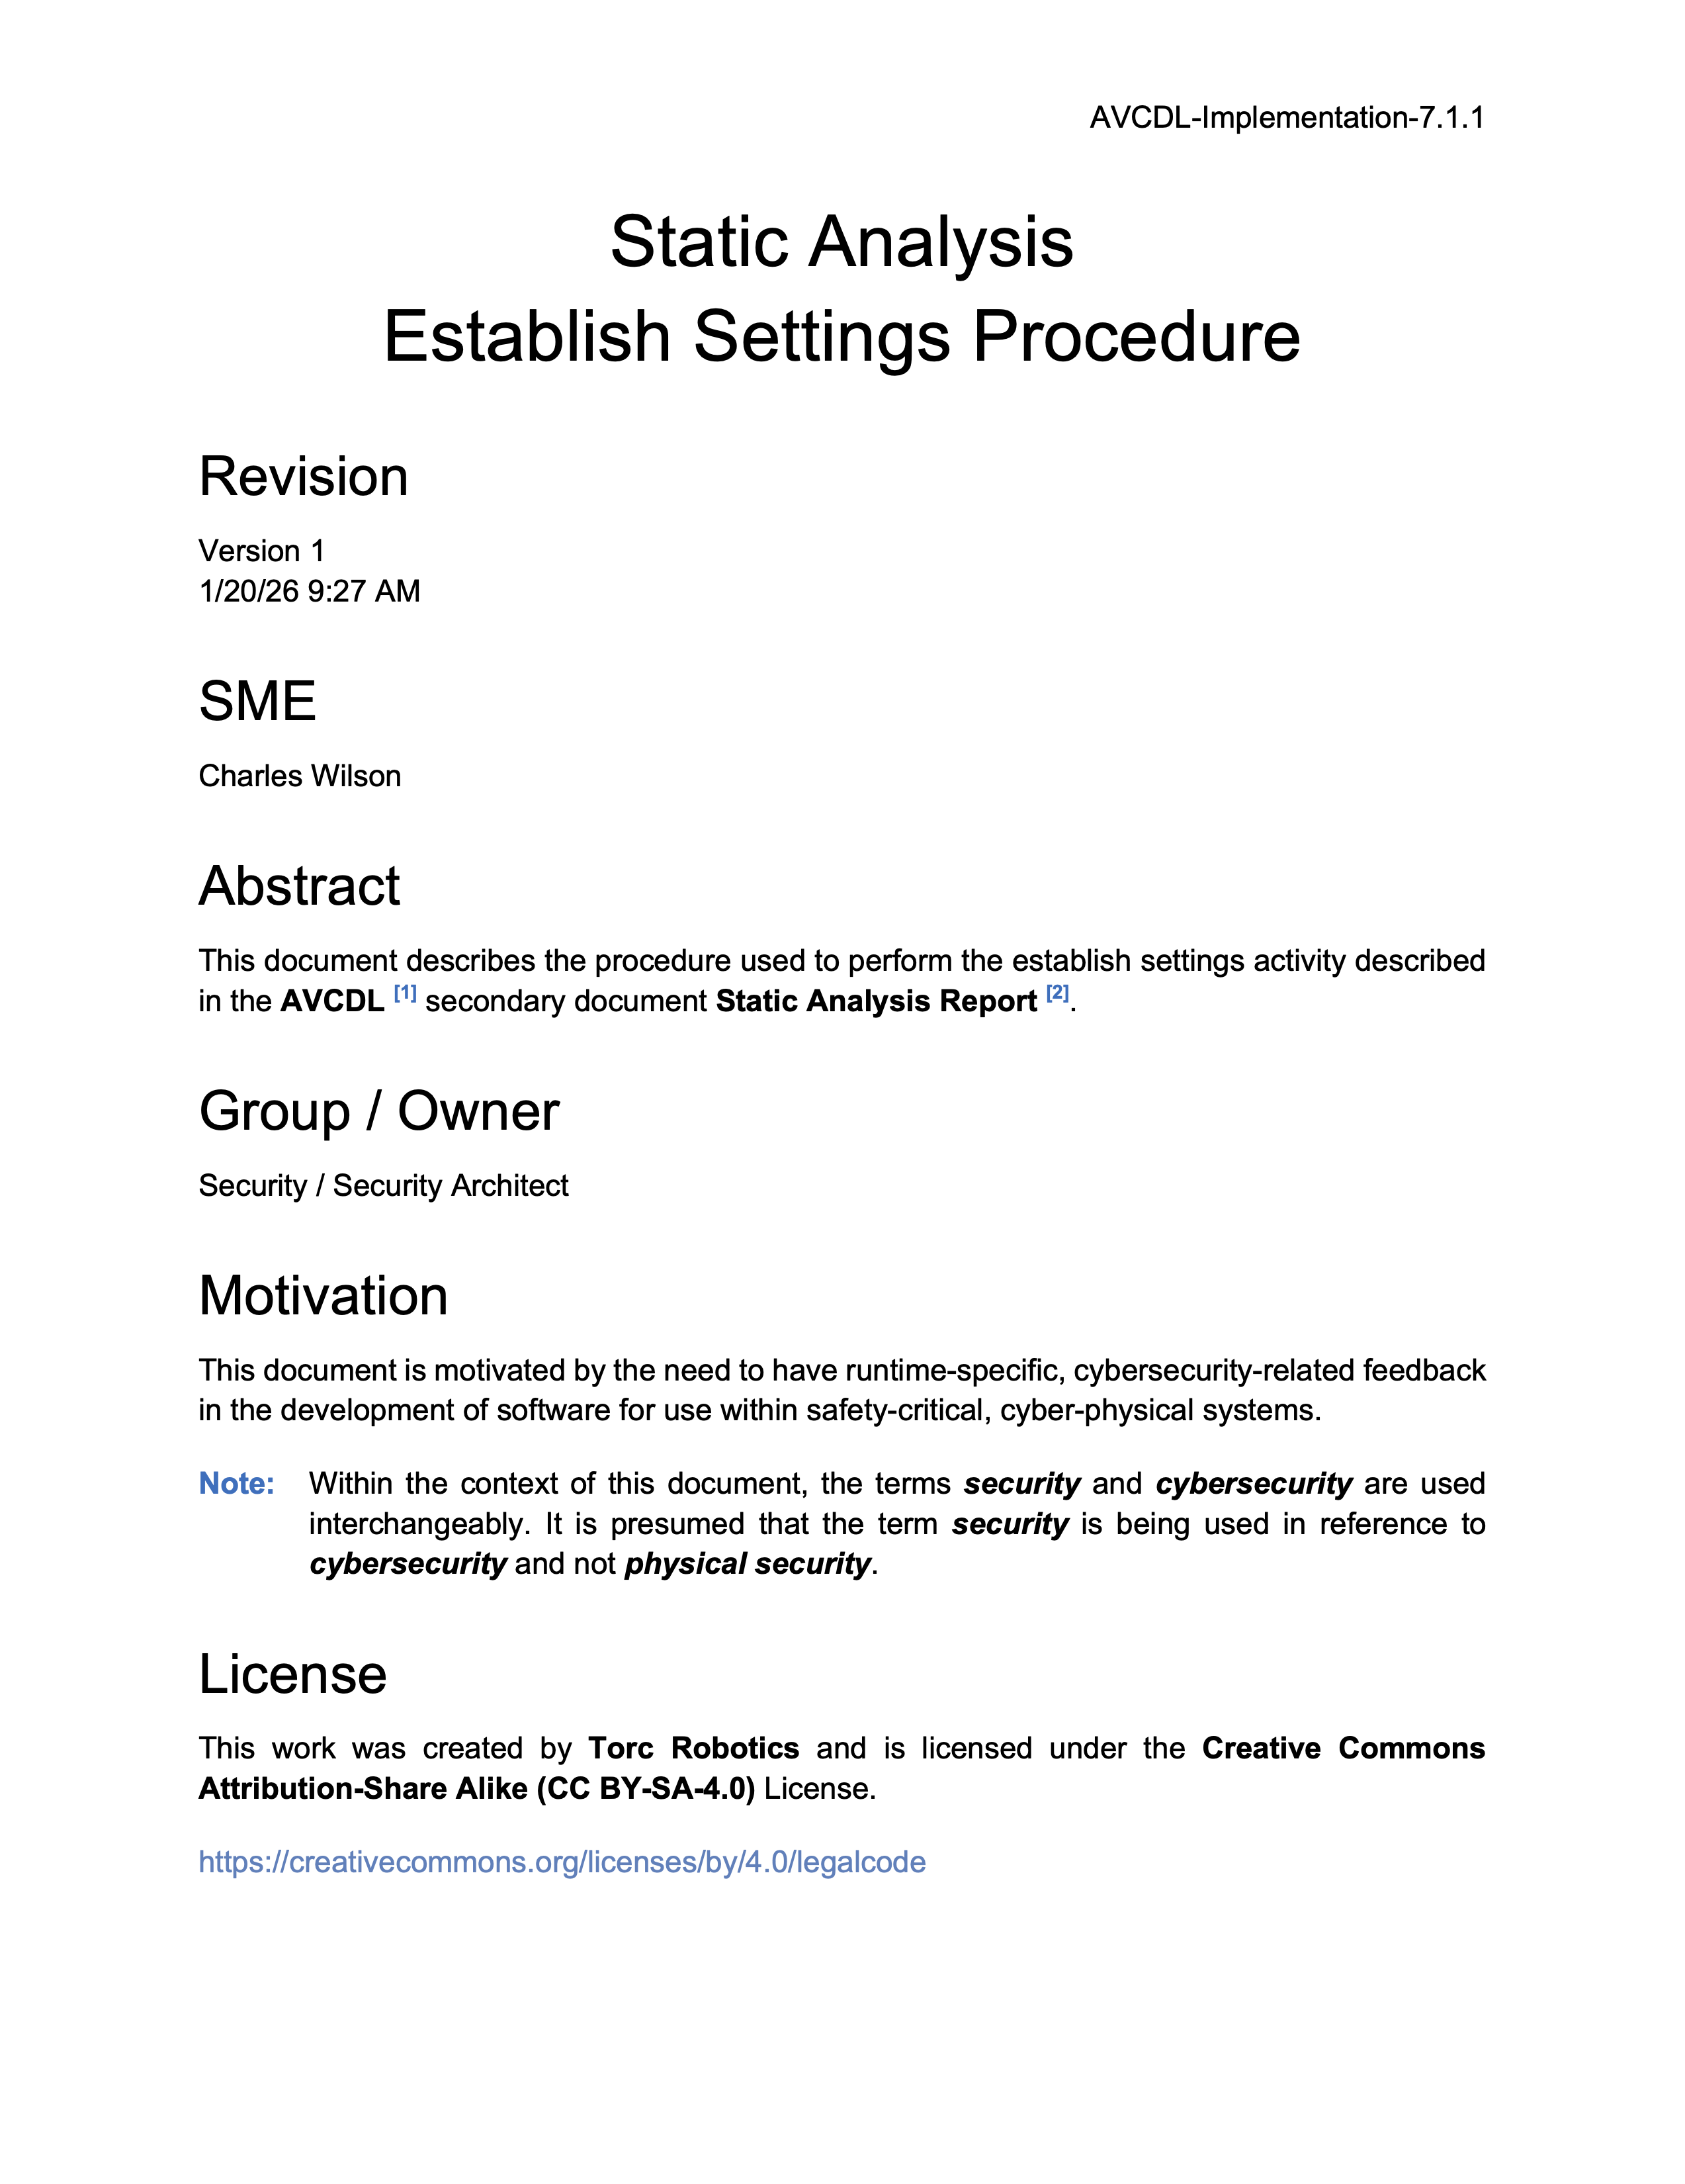
Further Reading
Notes:
Script:
For additional information and to get a more in-depth set of references, the Static Analysis Establish Settings Procedure tertiary document is available in the AVCDL GitHub repository.

Slide 24
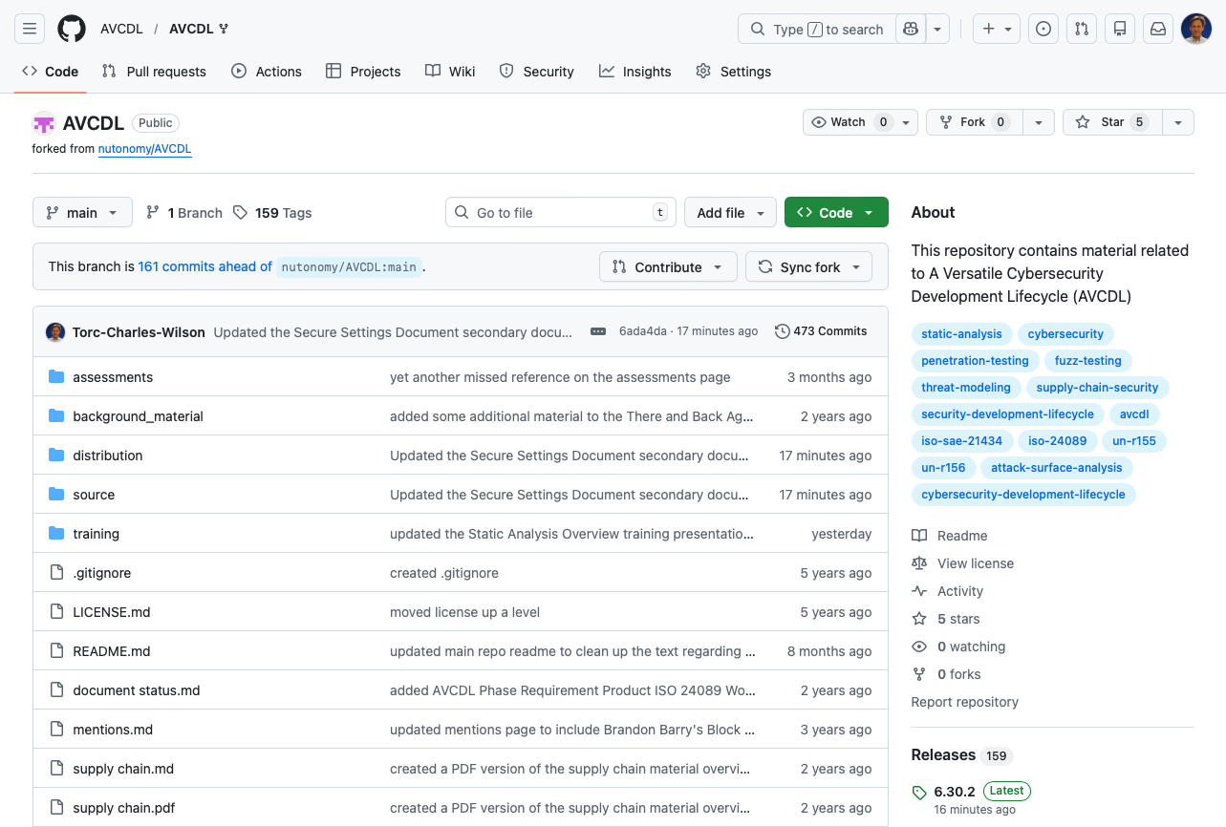
AVCDL on GitHub
https://github.com/AVCDL/AVCDL
Notes:
Script:
All AVCDL materials, both in source and distribution forms, are available on our GitHub site, as shown here.
Because of the size of the repository, it's recommended that you either clone the repository or download a ZIP archive of it, if you're not familiar with using git.
Instructions for downloading a ZIP archive are linked to on the repository’s front page.

Slide 25
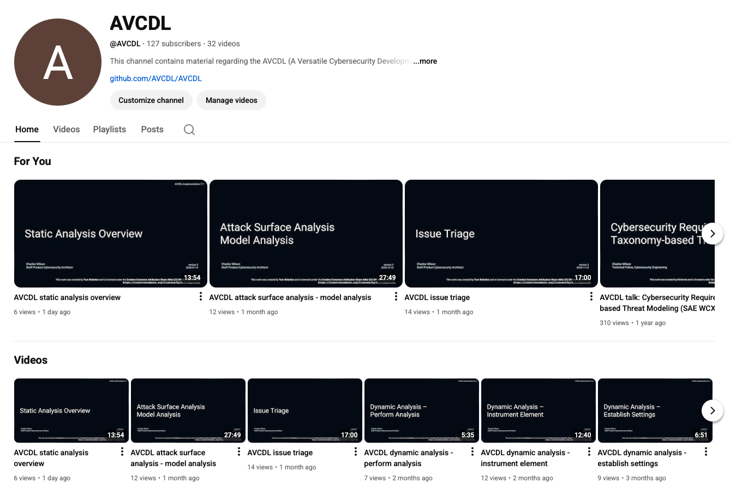
AVCDL on YouTube
https://youtube.com/@AVCDL
Notes:
Script:
Videos covering various aspects of the AVCDL are available on our YouTube channel, as shown here.
It's important to note that all AVCDL materials with the exception of the introductory blog posts are intended for product cybersecurity engineering practitioners.

Slide 26
Next Steps
Notes:
Script:
With this training complete, if you’ve completed the other trainings covering the Static Analysis process activities, you can proceed to the other training at this level, these include:
Dynamic Analysis
Fuzz Testing
and
Secure Code Review

Slide 27
References
AVCDL primary document
Static Analysis Report (AVCDL secondary document)
Static Analysis – Establish Settings Procedure (AVCDL tertiary document)
Secure Settings Document (AVCDL secondary document)
Secure Settings – Identify Options Procedure (AVCDL tertiary document)
Secure Settings – Categorize Options Procedure (AVCDL tertiary document)
Secure Settings – Select Options Procedure (AVCDL tertiary document)
Secure Settings – Apply Options Procedure (AVCDL tertiary document)
AVCDL tool cybersecurity options template (AVCDL template)
AVCDL element-specific tool cybersecurity options template (AVCDL template)
List of tools for static code analysis
https://en.wikipedia.org/wiki/List_of_tools_for_static_code_analysis
Notes:
Script:
Here are the references to the source material used in the creation of this presentation.
They'll also be included in the video description.
Additionally, this presentation’s source material will be provided on the AVCDL GitHub repository.

